Slide 1
Healthy Home Prediction
-Bowen Xiao
-Jiayu Liu
-Zheqi Sun

Slide 2
The Main Purpose of This Project
Insurance companies are likely to pay particular attention to the air quality index that may affect human’s health.
Our project aims to predict the level of NO, NO2 and PM 2.5. A high level of these indexes often leads to a higher probability of lung cancer. Therefore, we assume people who live in an area with a low concentration of NO, NO2 and PM2.5 tend to be healthier.
Our project also tries to find out which elements have a major impact on the level of NO, NO2 and PM2.5, which can help insurance companies customize insurance plans for customers living in different areas.

Slide 3
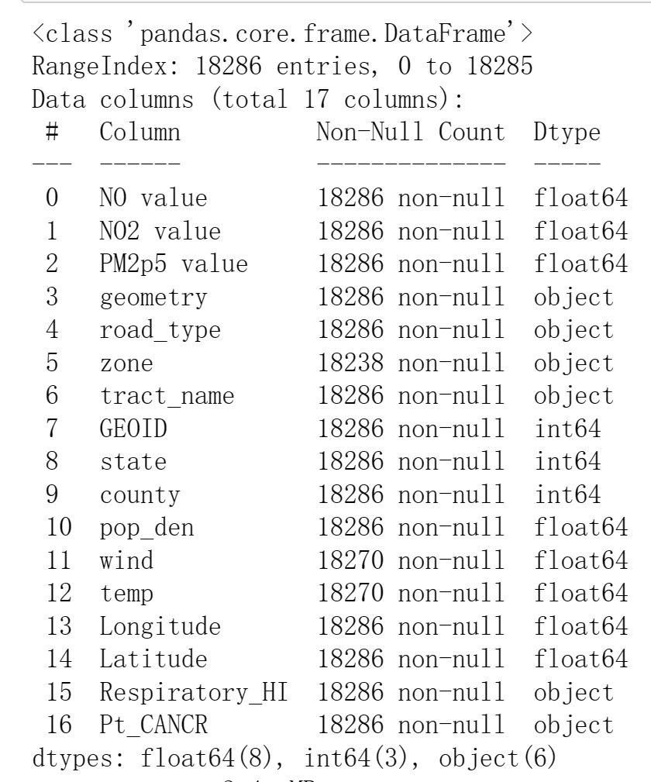
Step 1 Data Loading and Cleaning
Data are obtained from Kaggle. The features include NO value, NO2 value, PM2P5 value, geometry, road_type, zone, trace_name, GEOID, state, country, population density, wind, temperature, longitude, latitude, Reposiratory_HI and PT_CANCER.
Data information:

Slide 4
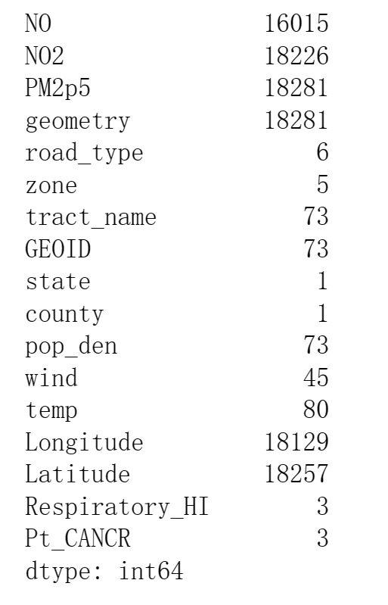
Check for the number of unique value:
Useless features to be dropped: state, country, tract_name and GEOID

Slide 5
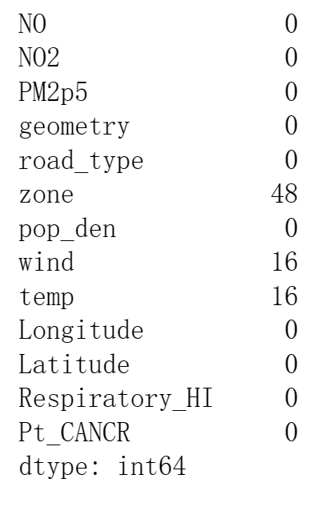
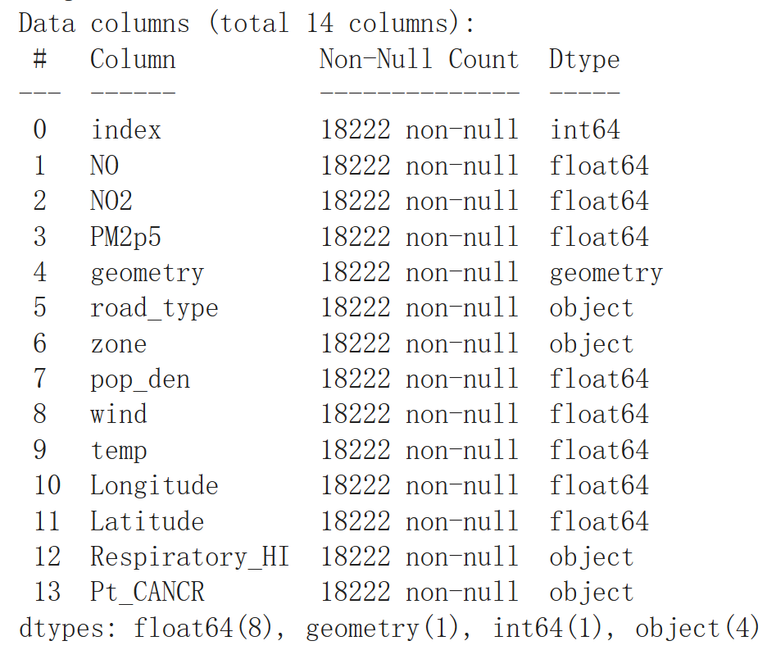
Check for the null value:
Data after dropping N/A:

Slide 6
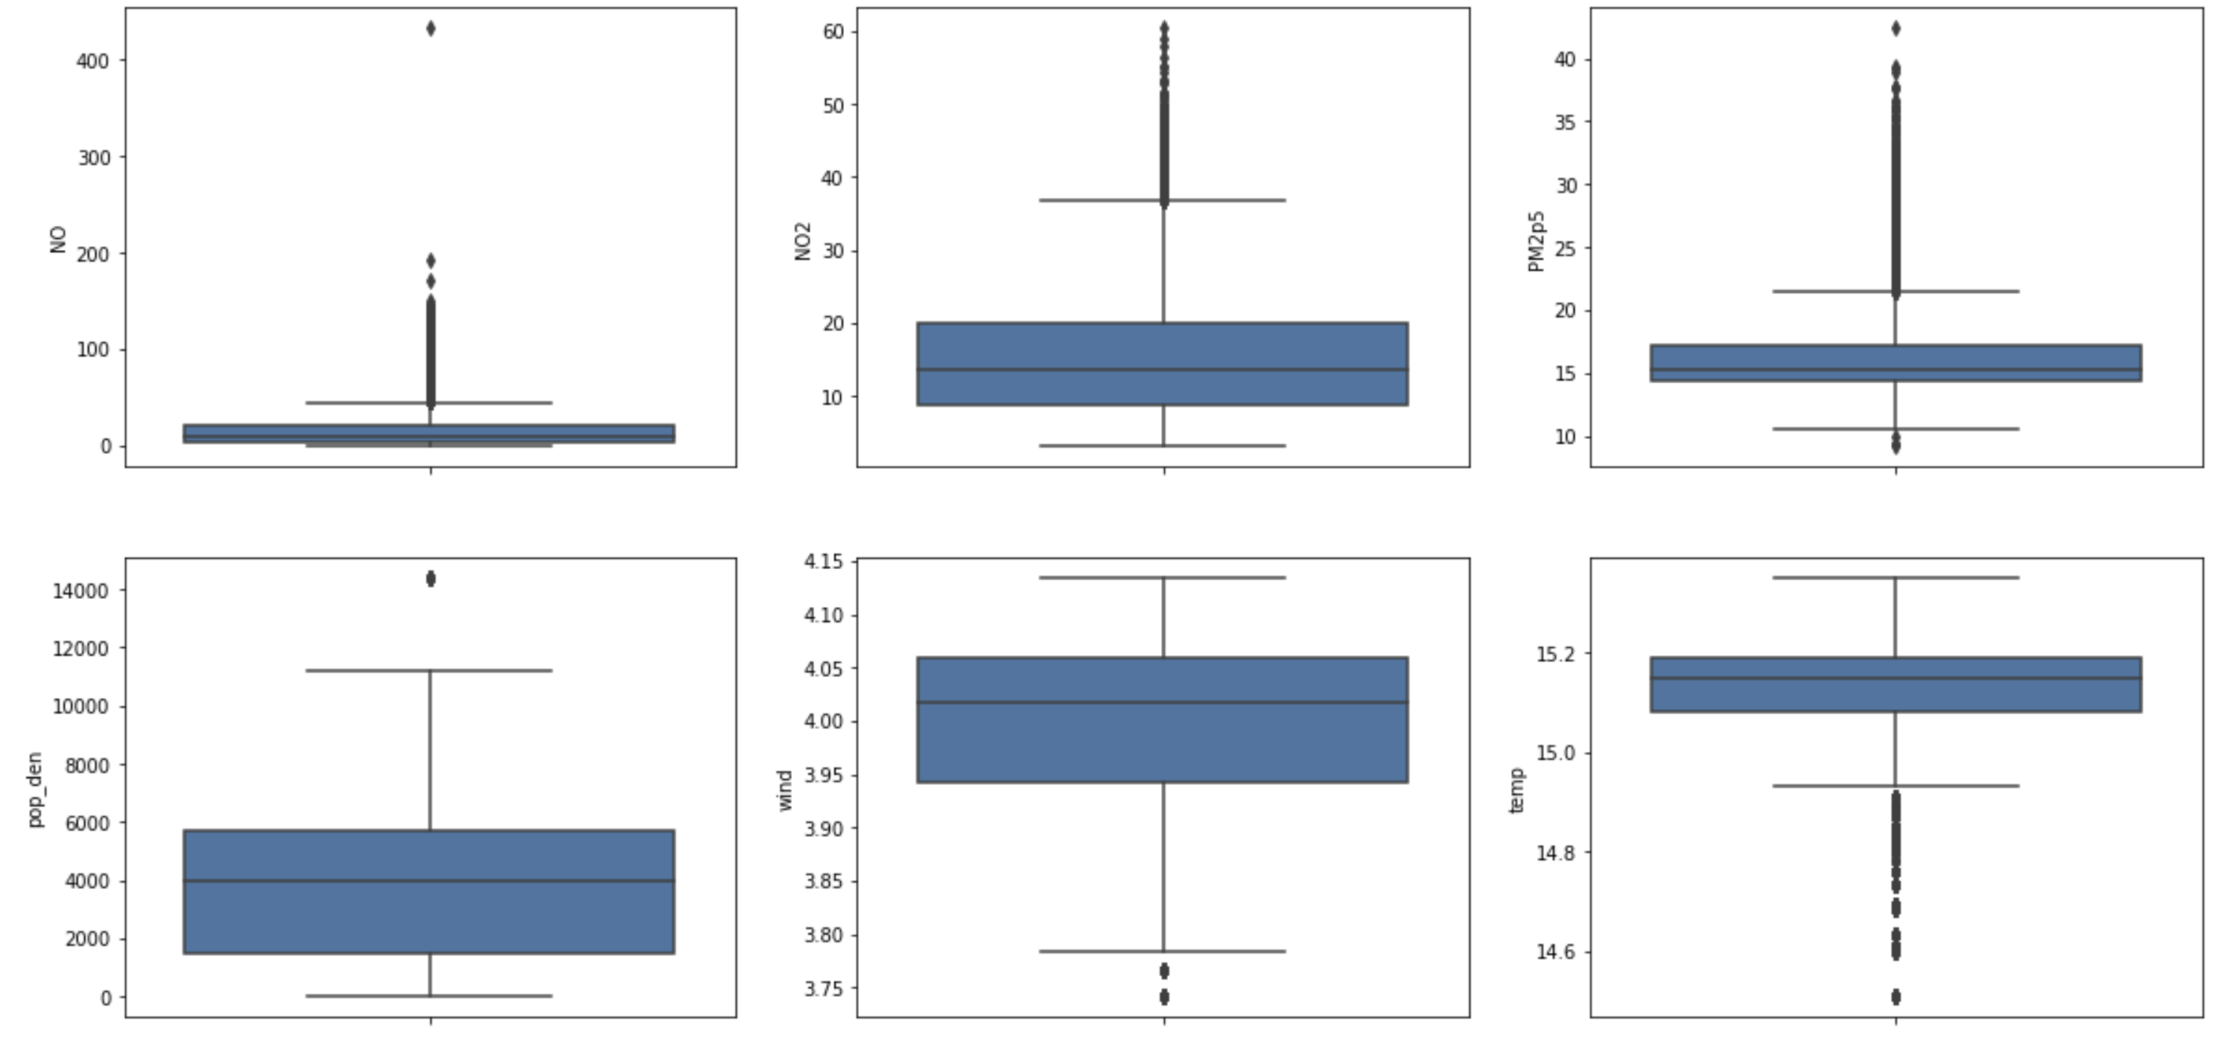
Check for outliers (using boxplot):

Slide 7
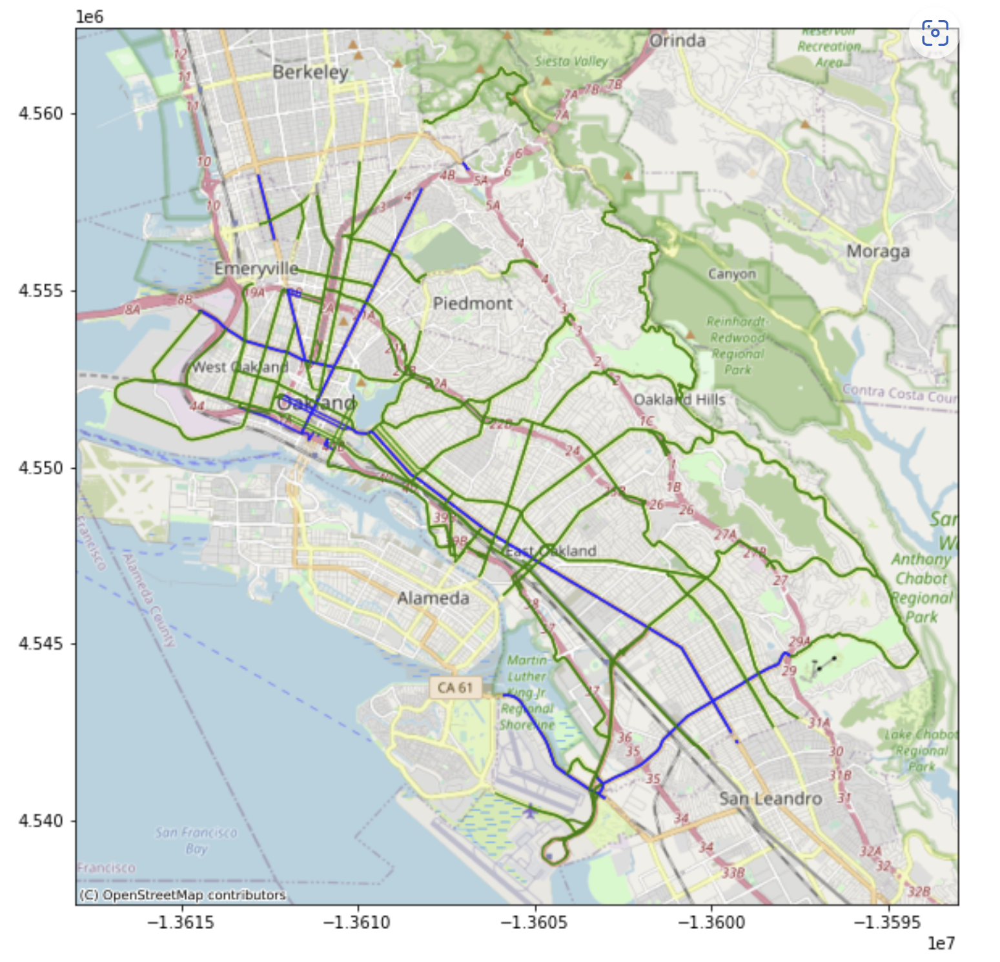
Step 2 Feature Engineering
Oakland road map:

Slide 8
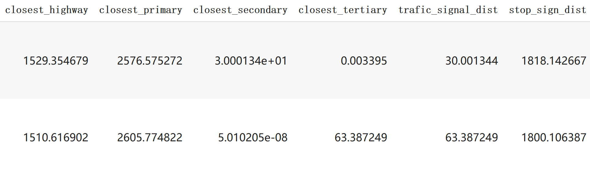
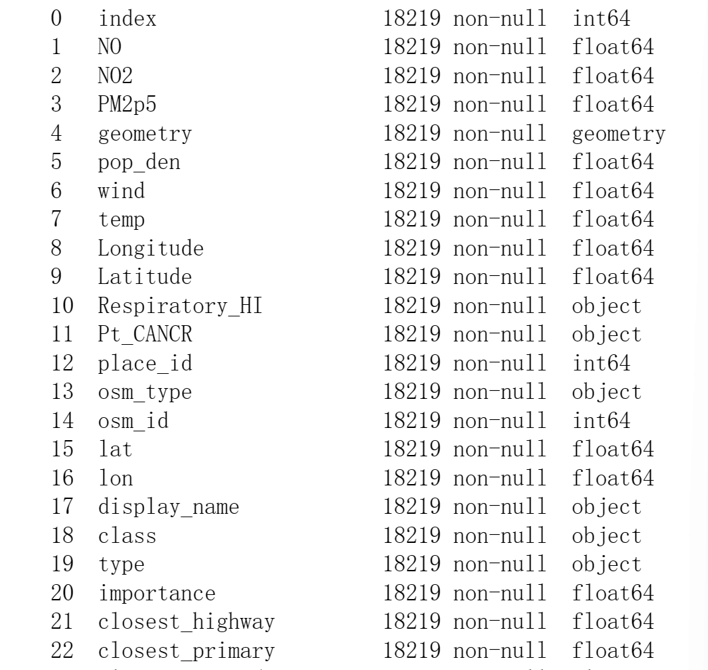
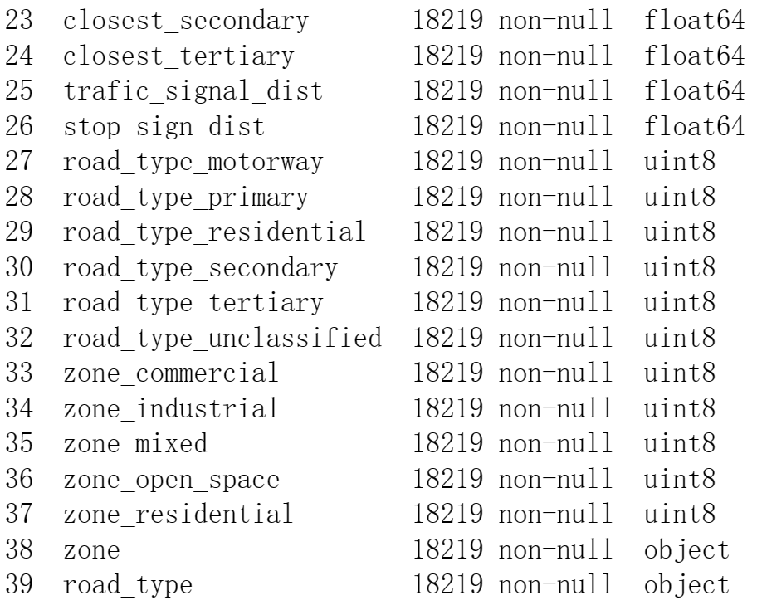

Slide 9
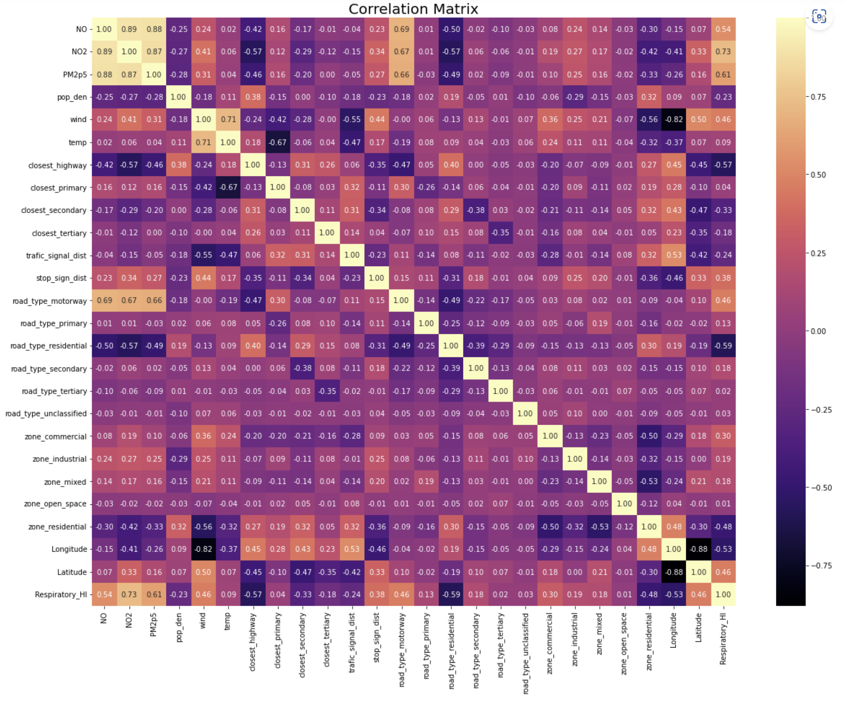

Slide 10
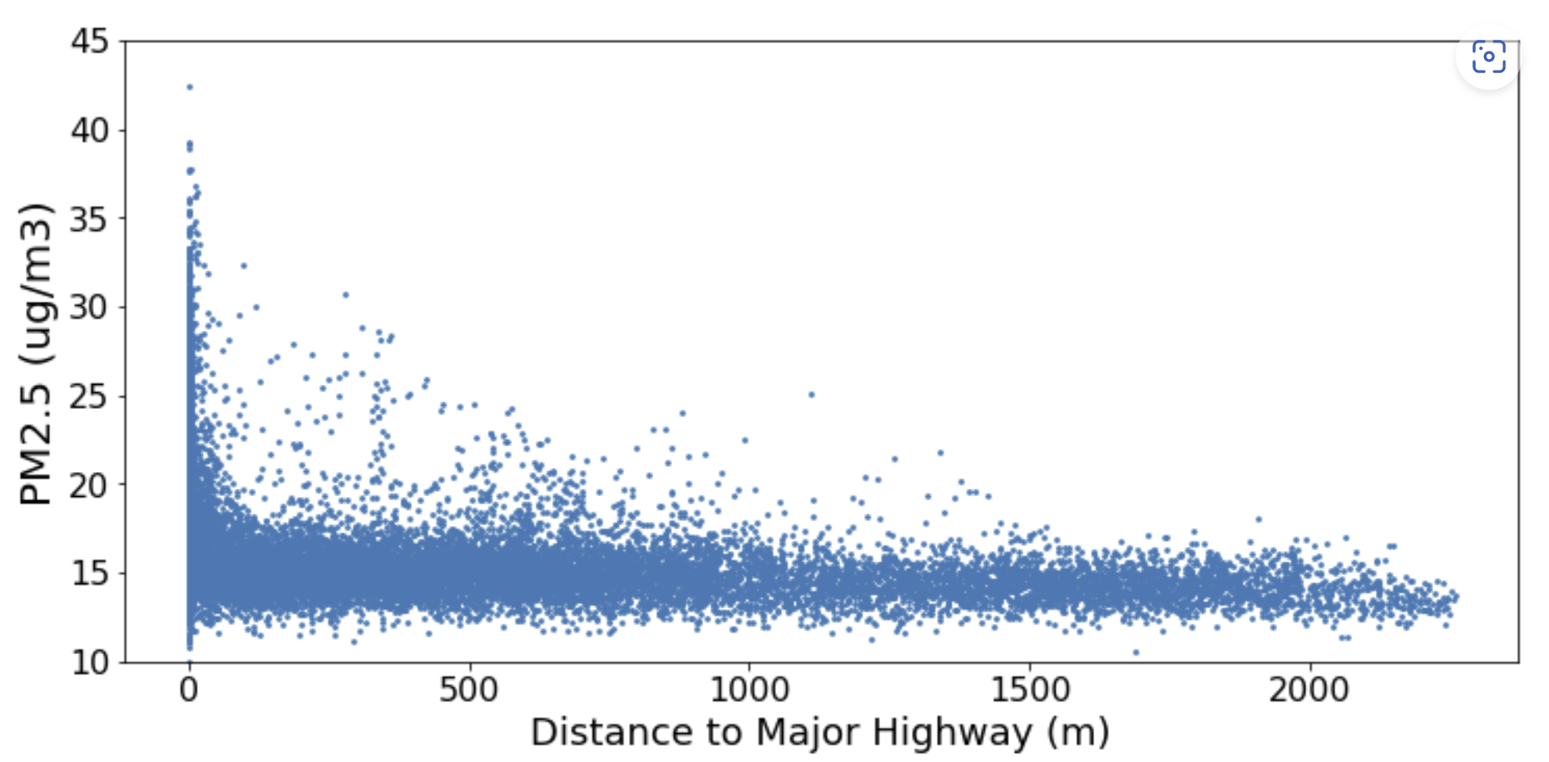
Scatter Plot of PM2.5 and Distance to Major Highway

Slide 11
Step 3 Modelling
Random Forest
Gradient Boosting

Slide 12
NO2
 | Random Forest | Gradient Boosting
Best Estimator | max_features = 10 N_estimator = 200 | max_features = 10 N_estimator = 200 learning_rate = 0.5
Training Set
Best RMSE | 2.30918 | 2.98112
Test Set
RMSE | 2.12202 | 2.82791
R2 | 0.94452 | 0.90147

Slide 13
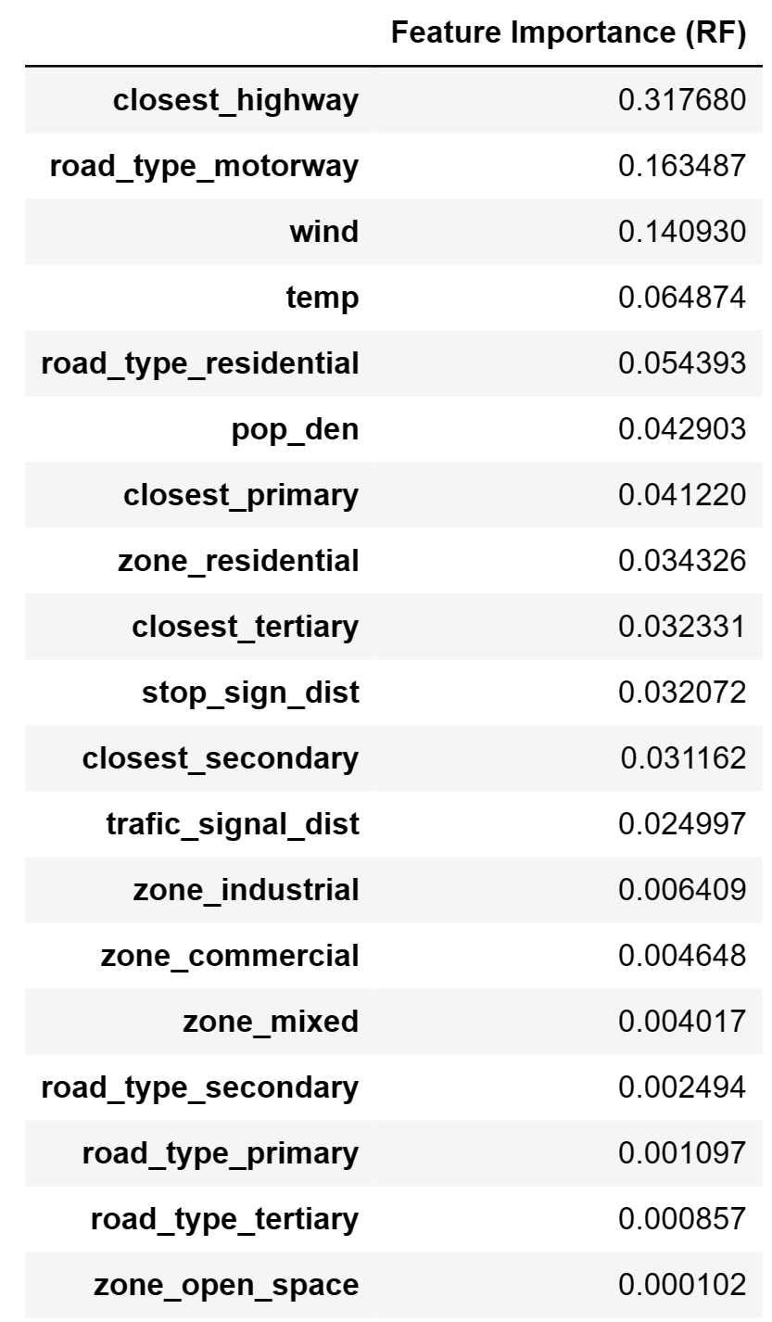
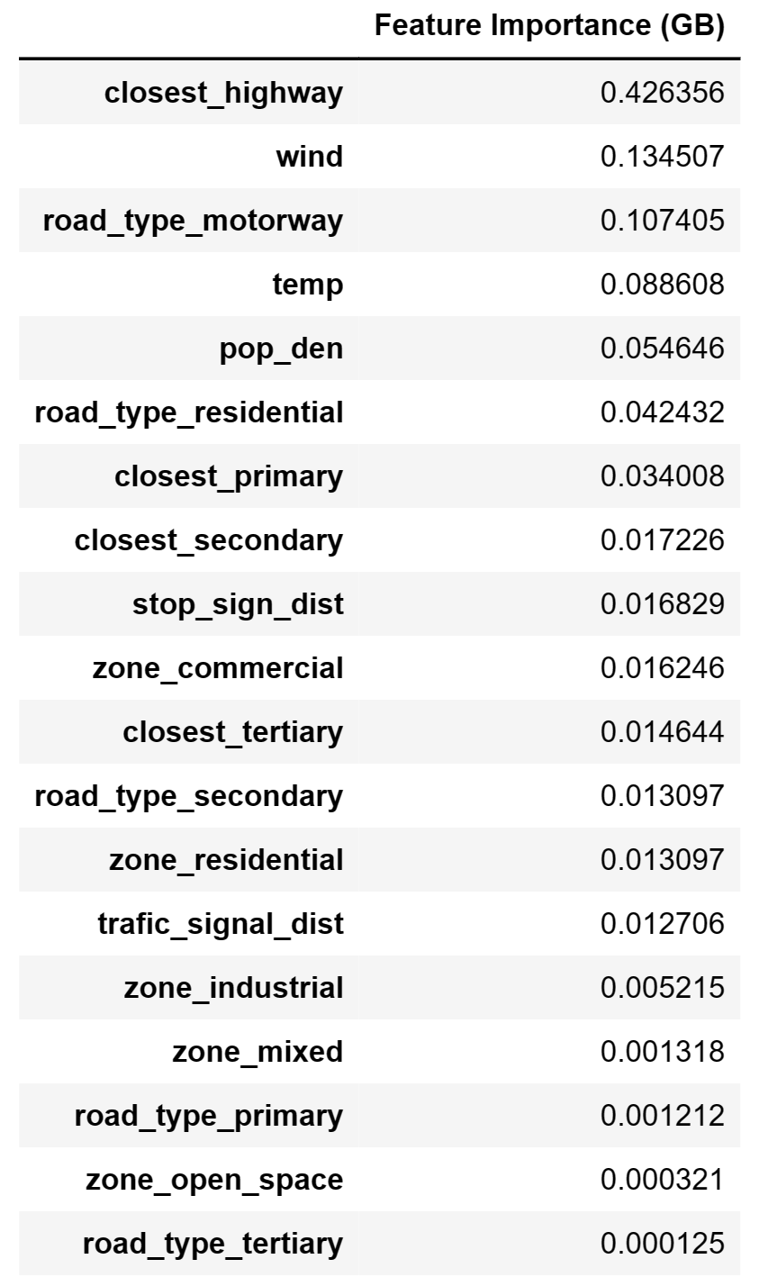
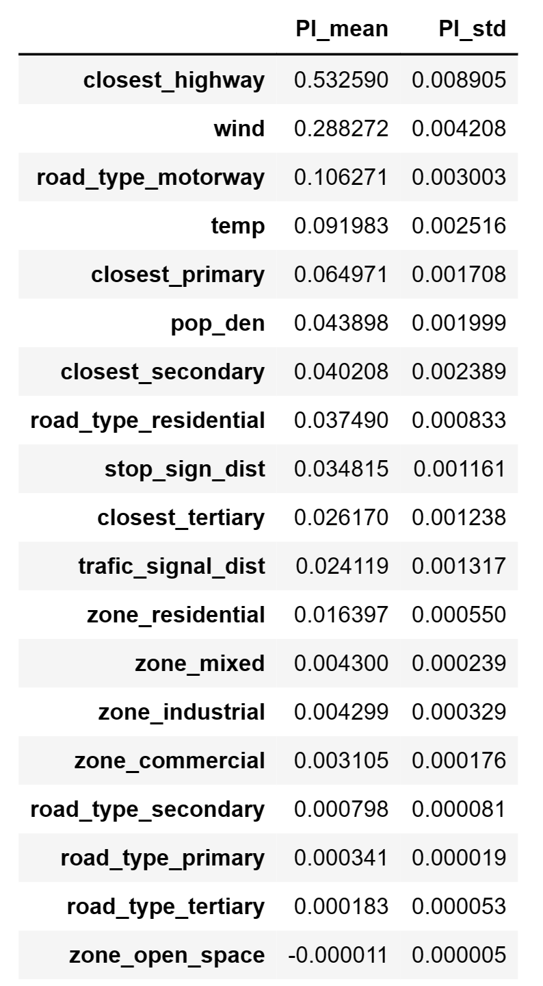
Feature Importance and Permutation Importance

Slide 14
NO
 | Random Forest | Gradient Boosting
Best Estimator | max_features = 10 N_estimator = 150 | max_features = 8 N_estimator = 200 learning_rate = 0.5
Training Set
Best RMSE | 6.34031 | 8.0045
Test Set
RMSE | 5.87267 | 7.81899
R2 | 0.91893 | 0.85628

Slide 15
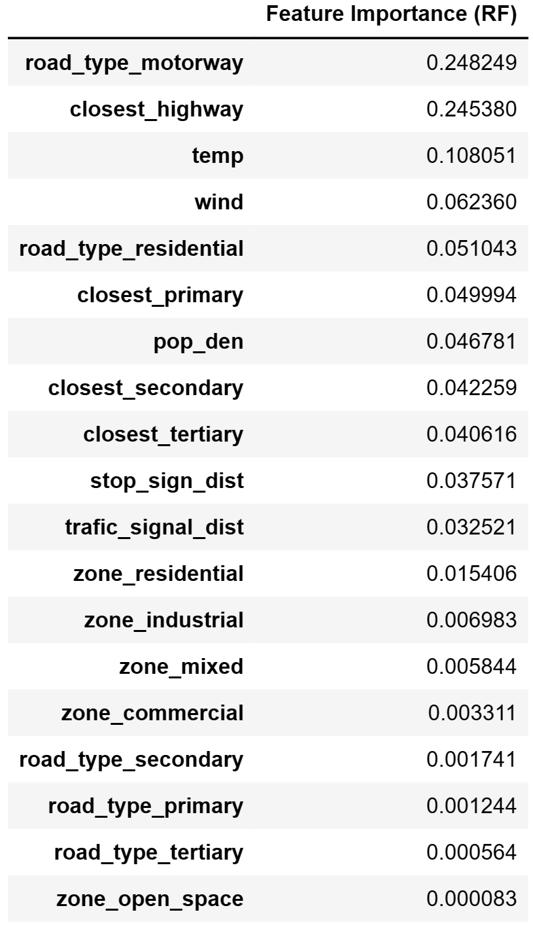
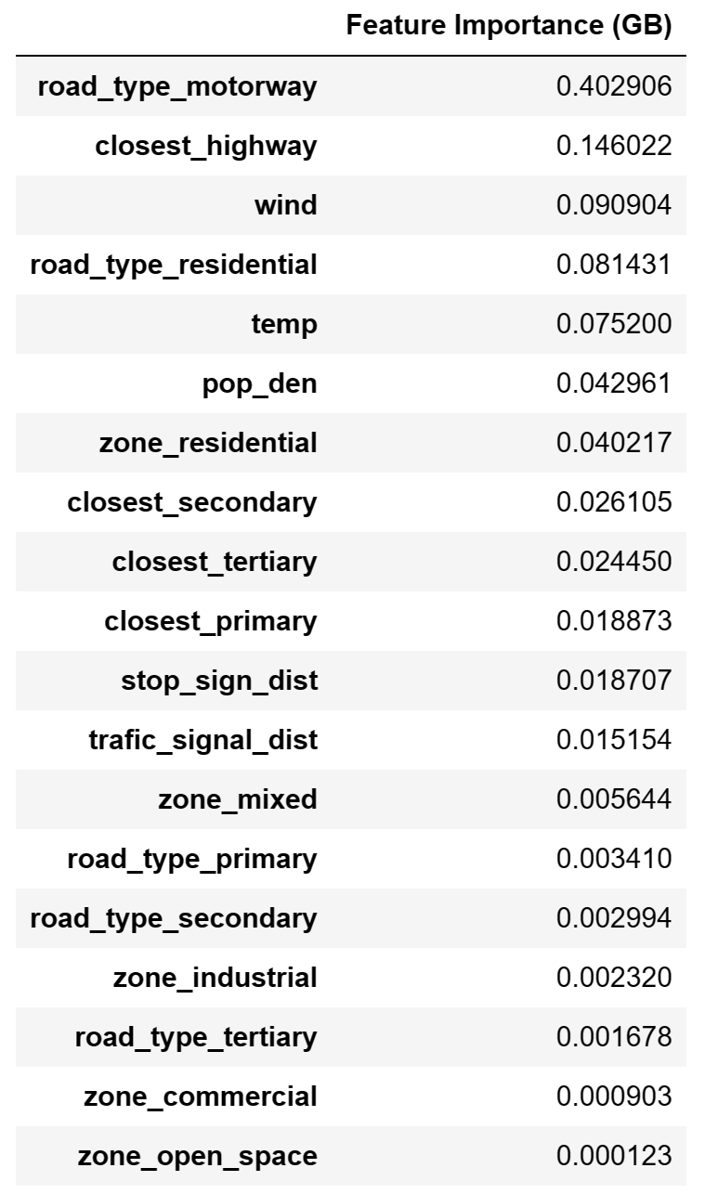
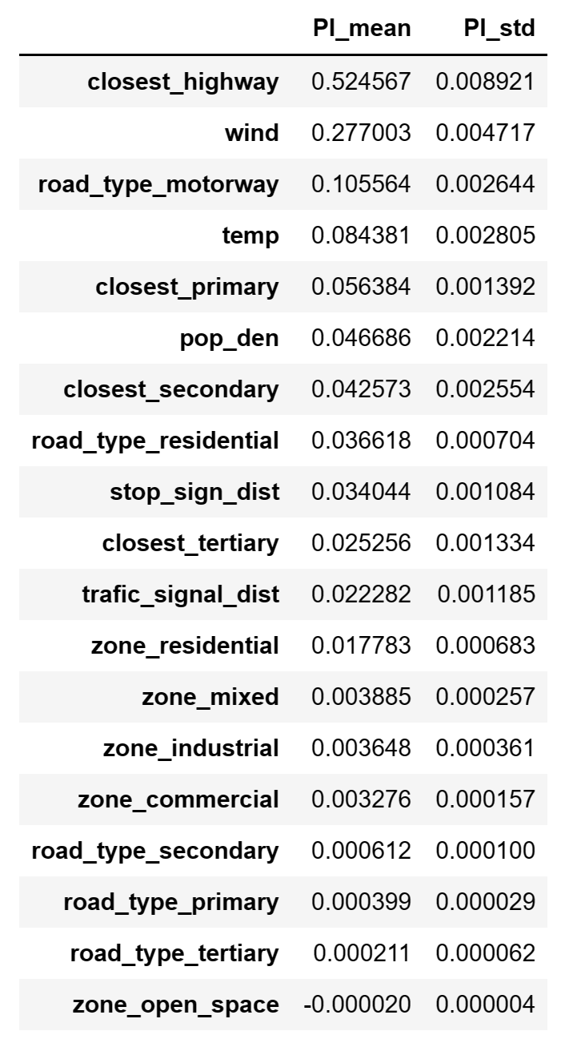
Feature Importance and Permutation Importance

Slide 16
PM2.5
 | Random Forest | Gradient Boosting
Best Estimator | max_features = 10 N_estimator = 250 | max_features = 10 N_estimator = 200 learning_rate = 0.5
Training Set
Best RMSE | 1.40934 | 1.60973
Test Set
RMSE | 1.32747 | 1.52008
R2 | 0.85056 | 0.80405

Slide 17
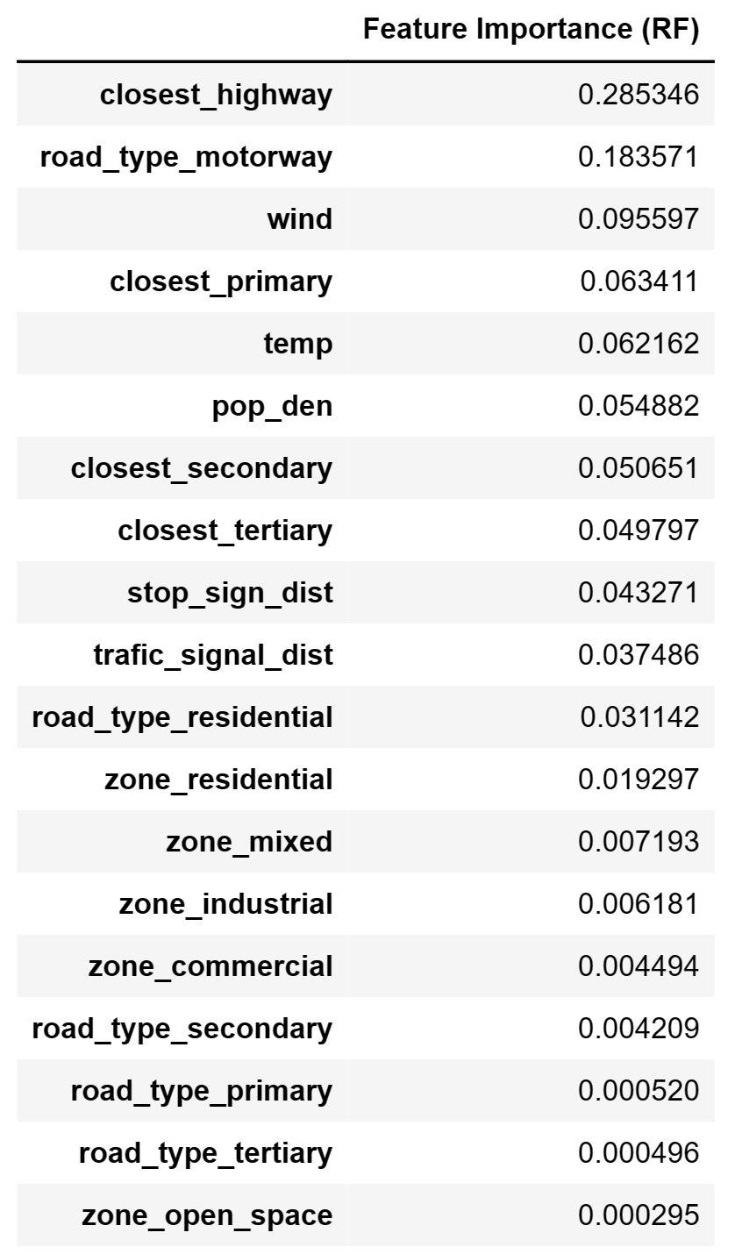
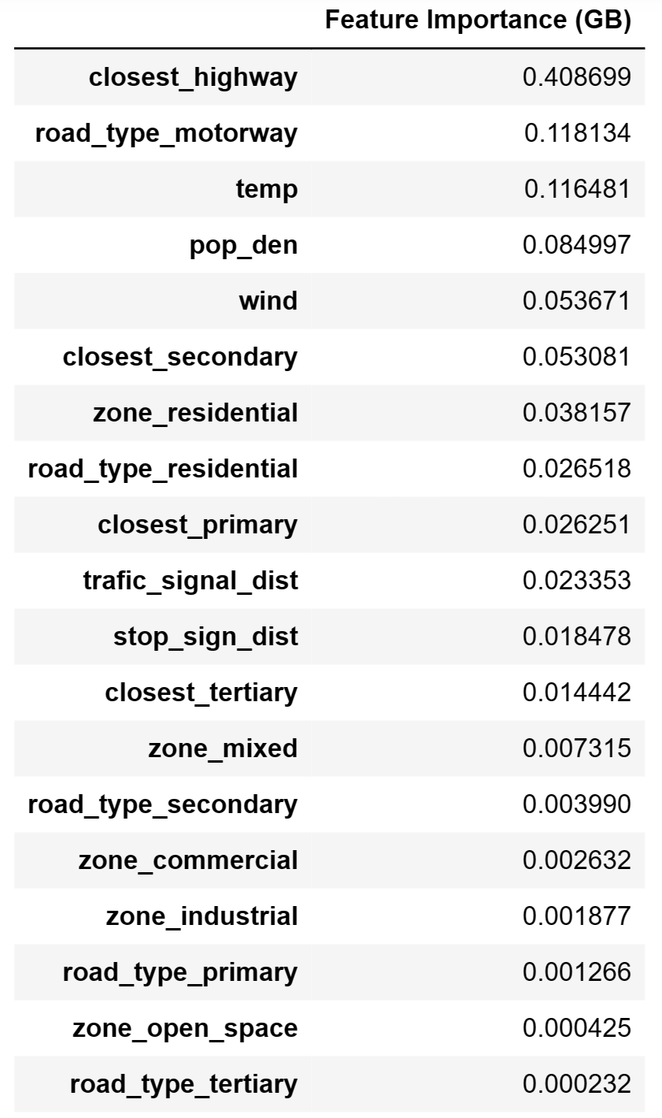
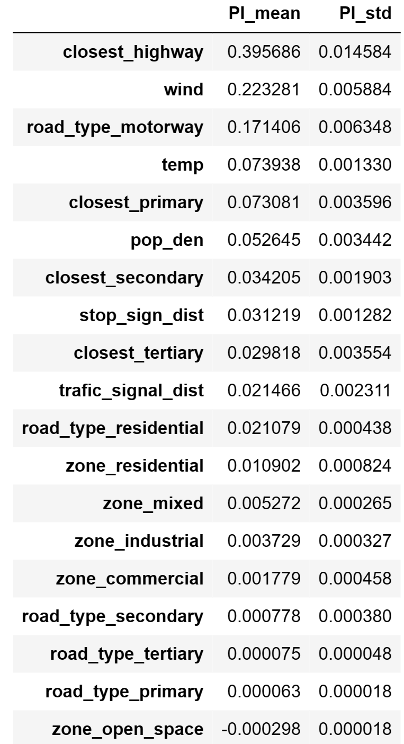
Feature Importance and Permutation Importance

Slide 18
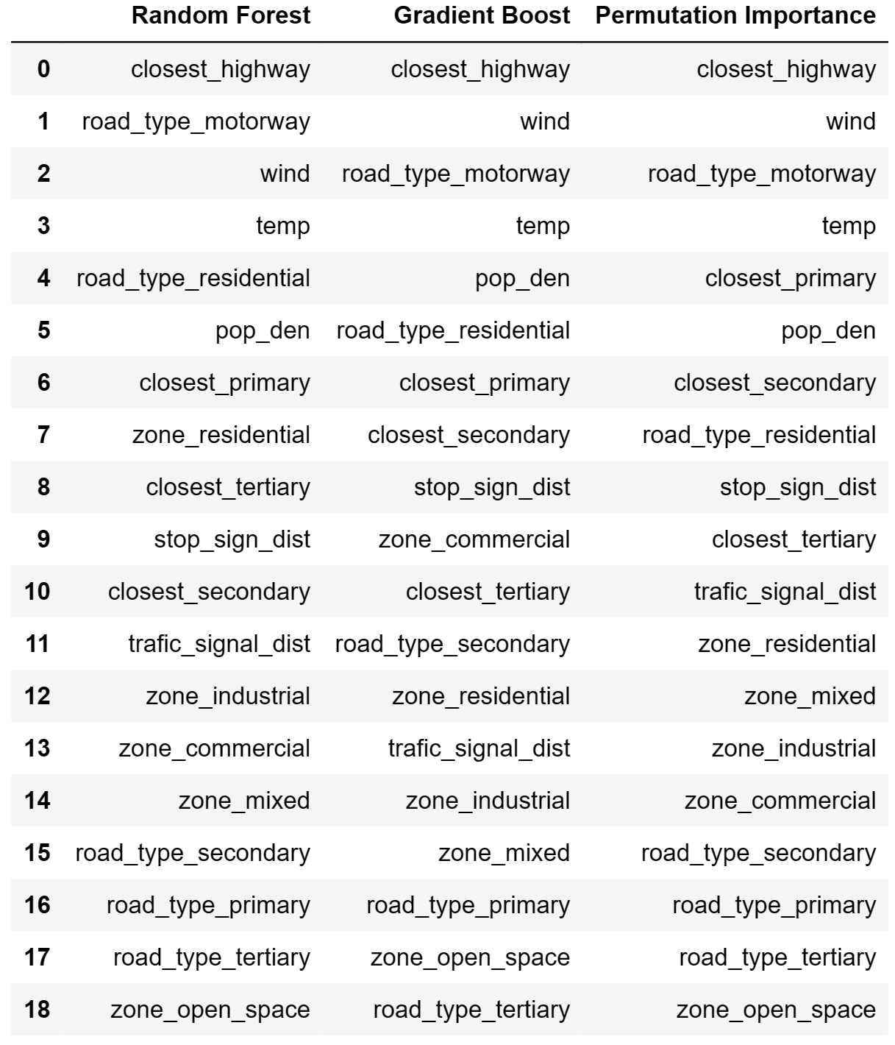
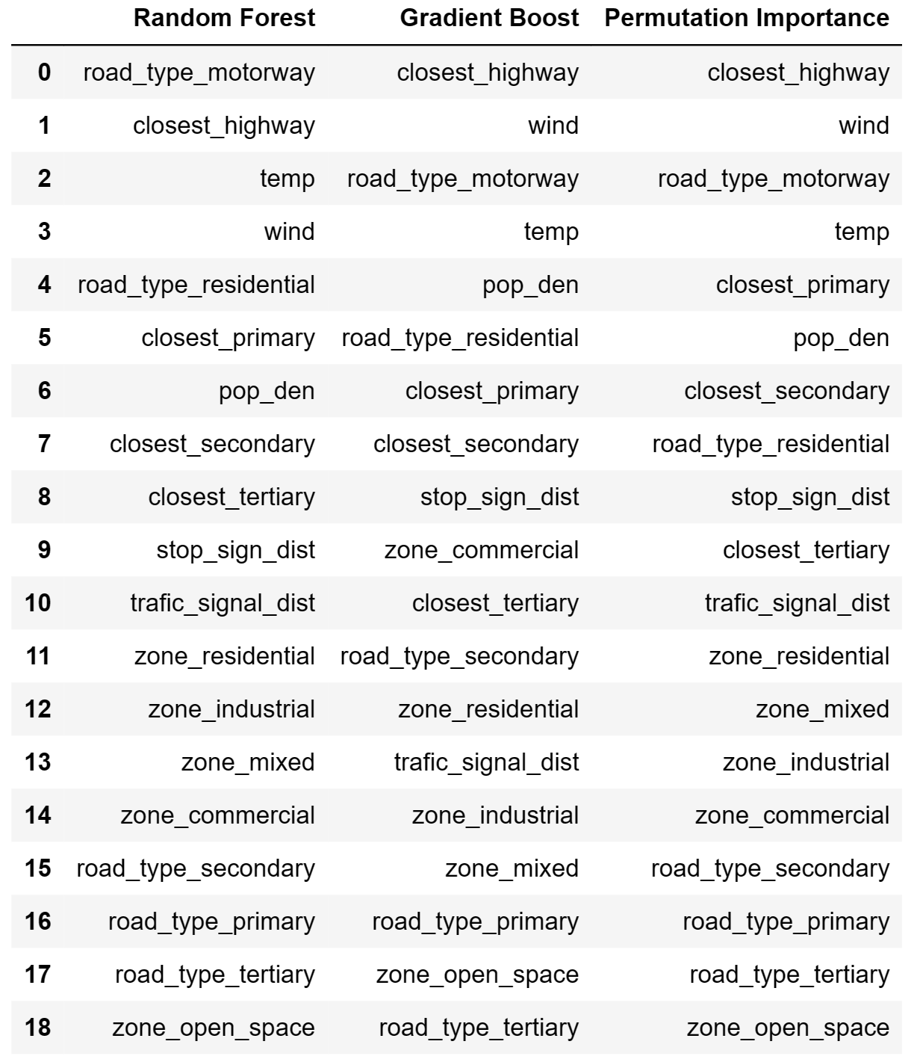
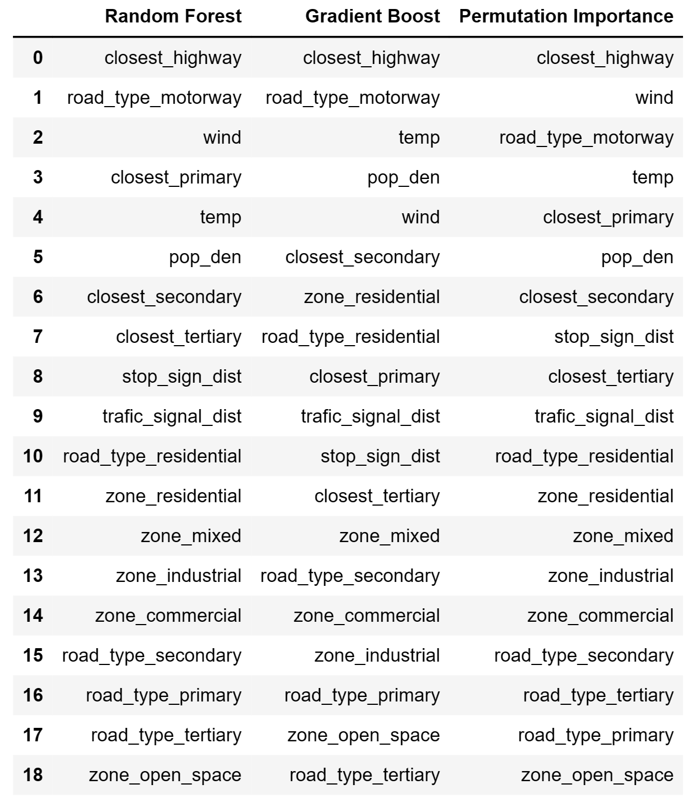
Summary
NO
NO2
PM2.5

